Slide 1


Fraud Detection
Report : Models with failed_transaction dropped after FE & EDA

Slide 2
Features & their correlation
‘Fraud_label’ is our target feature for the dataset, and the two features mentioned here are the most correlated features to the target feature.
In this version of the report, I dropped only the “failed_transaction_7d” after doing the FE & EDA.
After, that I used the different Machine Learning models as well as Deep Learning model ANN.
For tree-based models, I didn’t apply any scaling method.
For Distance based models, I used the Min Max scaler.
Fraud_Label 1.000000
Failed_Transaction_Count_7d 0.509871
Risk_Score 0.385810

Slide 3
Distance Based Algorithms
Logistic Regression
SVC
KNN
accuracy_score : 0.78632
Confusion matrix :
[[7747 701]
[1970 2082]]
precision recall f1-score support
0 0.80 0.92 0.85 8448
1 0.75 0.51 0.61 4052
accuracy 0.79 12500
macro avg 0.77 0.72 0.73 12500
weighted avg 0.78 0.79 0.77 12500
accuracy_score : 0.67584
Confusion matrix :
[[8448 0]
[4052 0]]
precision recall f1-score support
0 0.68 1.00 0.81 8448
1 0.00 0.00 0.00 4052
accuracy 0.68 12500
macro avg 0.34 0.50 0.40 12500
weighted avg 0.46 0.68 0.55 12500
accuracy_score : 0.63104
Confusion matrix :
[[7047 1401]
[3211 841]]
precision recall f1-score support
0 0.69 0.83 0.75 8448
1 0.38 0.21 0.27 4052
accuracy 0.63 12500
macro avg 0.53 0.52 0.51 12500
weighted avg 0.59 0.63 0.60 12500

Slide 4
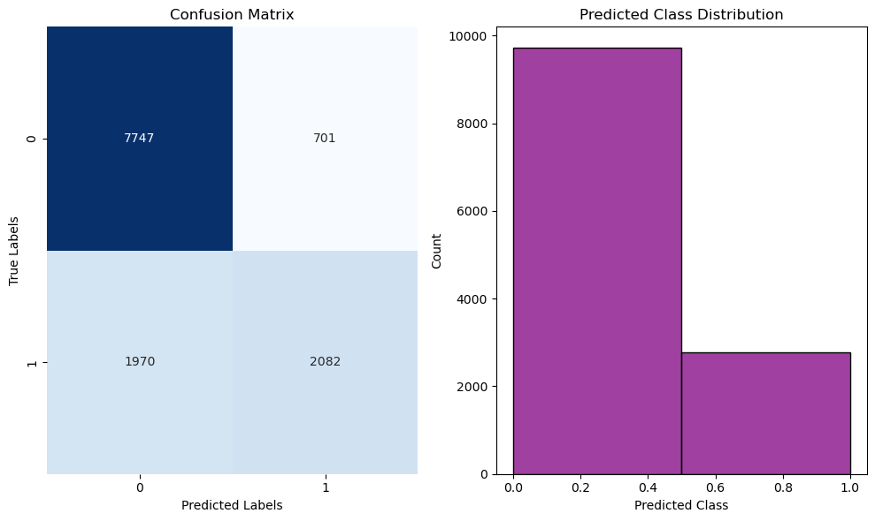
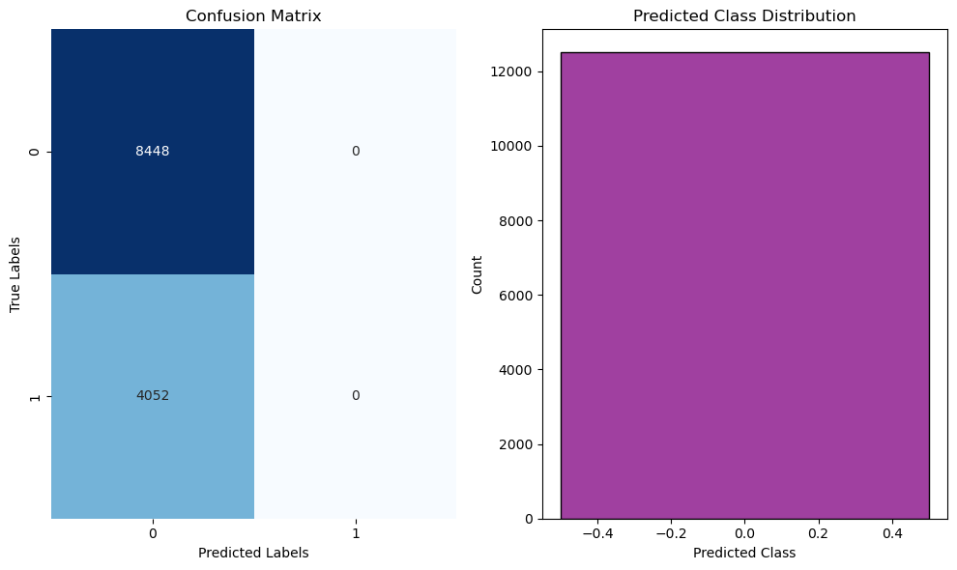
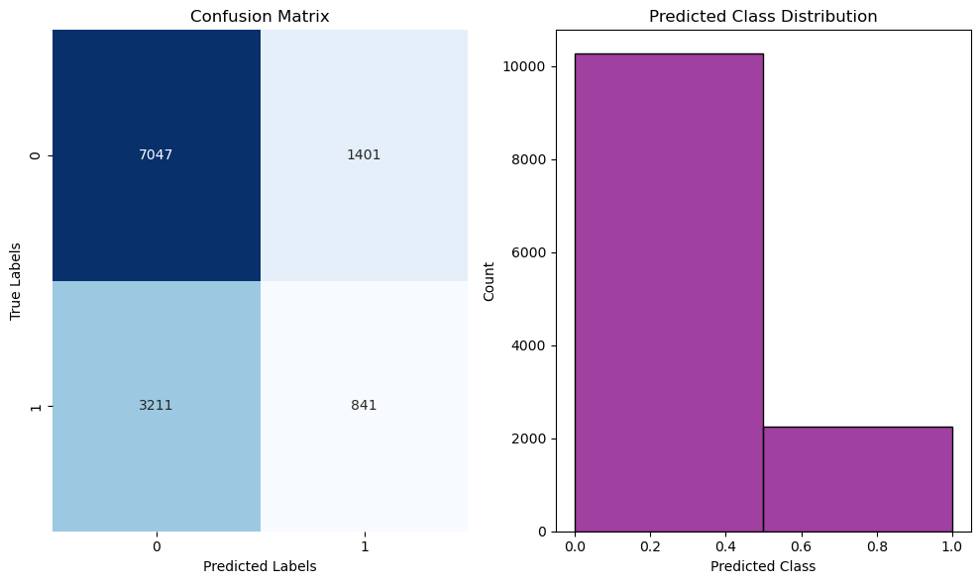
Graphs
Logistic Regression
SVC
KNN

Slide 5
Probability based Algorithm(NB)
accuracy_score : 0.67584
Confusion matrix :
[[8448 0]
[4052 0]]
precision recall f1-score support
0 0.68 1.00 0.81 8448
1 0.00 0.00 0.00 4052
accuracy 0.68 12500
macro avg 0.34 0.50 0.40 12500
weighted avg 0.46 0.68 0.55 12500

Slide 6
Tree Based Algorithms
Decision Tree
Random Forest
Adaboost
accuracy_score : 0.71704
Confusion matrix :
[[6550 1898]
[1639 2413]]
precision recall f1-score support
0 0.80 0.78 0.79 8448
1 0.56 0.60 0.58 4052
accuracy 0.72 12500
macro avg 0.68 0.69 0.68 12500
weighted avg 0.72 0.72 0.72 12500
accuracy_score : 0.82864
Confusion matrix :
[[8448 0]
[2142 1910]]
precision recall f1-score support
0 0.80 1.00 0.89 8448
1 1.00 0.47 0.64 4052
accuracy 0.83 12500
macro avg 0.90 0.74 0.76 12500
weighted avg 0.86 0.83 0.81 12500
accuracy_score : 0.82848
Confusion matrix :
[[8445 3]
[2141 1911]]
precision recall f1-score support
0 0.80 1.00 0.89 8448
1 1.00 0.47 0.64 4052
accuracy 0.83 12500
macro avg 0.90 0.74 0.76 12500
weighted avg 0.86 0.83 0.81 12500

Slide 7
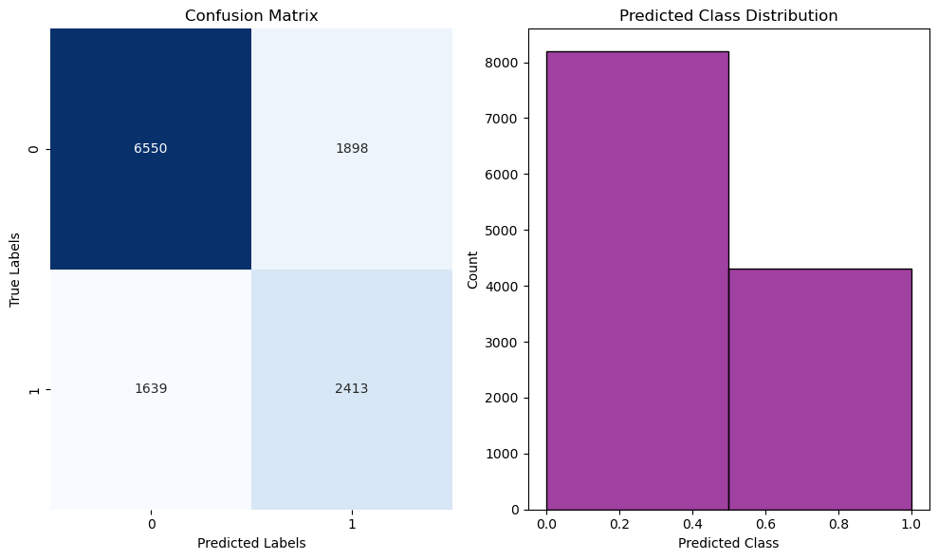
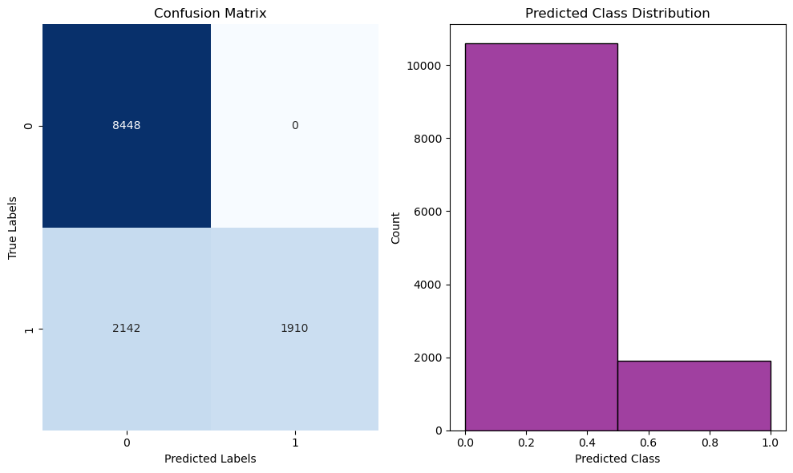

Graphs
Decision Tree
Random Forest
Adaboost

Slide 8



Gradient boost (Tree based)
accuracy_score : 0.82848
Confusion matrix :
[[8446 2]
[2142 1910]]
precision recall f1-score support
0 0.80 1.00 0.89 8448
1 1.00 0.47 0.64 4052
accuracy 0.83 12500
macro avg 0.90 0.74 0.76 12500
weighted avg 0.86 0.83 0.81 12500 0.51 0.67 0.55 12500

Slide 9
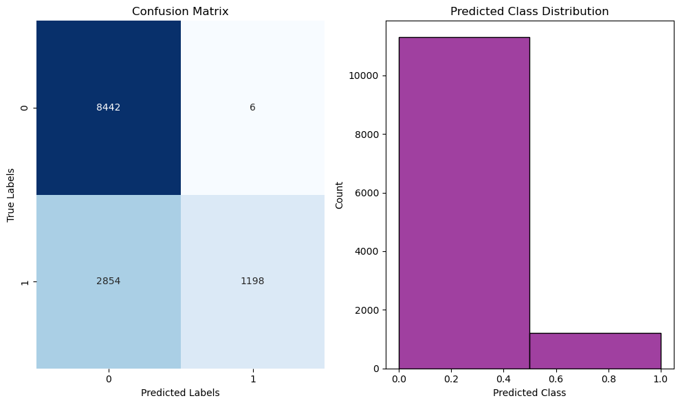
ANN(Deep learning model)
accuracy_score : 0.7712
Confusion matrix :
[[8442 6]
[2854 1198]]
precision recall f1-score support
0 0.75 1.00 0.86 8448
1 1.00 0.30 0.46 4052
accuracy 0.77 12500
macro avg 0.87 0.65 0.66 12500
weighted avg 0.83 0.77 0.73 12500

